Slide 1
Upgrading 2007 Solutions for SharePoint 2010
Notes:
Upgrading 2007 Solutions for SharePoint 2010
This module covers how to upgrade VSeWSS projects to the new SharePoint Tools in Visual Studio 2010. The first part of the deck is specific to VSeSS. Other parts provide more general guidance that also applies to upgrading projects created using other tools than VSeWSS.
The focus of this module is on the general upgrade process of solutions targeting SharePoint Foundation.
Farm upgrades, like how to move 2007 Shared Services to 2010 Service Applications, are not covered.
Lecture 11: Partial Trust Code - 1

Slide 2
Agenda
Upgrading Projects to Visual Studio 2010
Upgrading Projects to SharePoint 2010
Integrating with SharePoint 2010
Notes:
When it comes to upgrading SharePoint solutions to SharePoint 2010 there are three main steps that you need to take.
First you import the VSeWSS project into Visual Studio 2010. For VSeWSS there is a special type of import project template that you can use to import the existing VSeWSS project layout and settings. This step only gets you into Visual Studio. Your code files do change, but not in a significant way. So, you cannot just press F5 after doing the import (well, you can of course cross your fingers….)
Next you need to take a look at the features that your solutions uses and whether they are still supported in 2010. Some good examples to mention here are some of the deprecated APIs and the move to the IIS integrated pipeline (resulting in a different way of registering custom http handlers and modules, which are often used in SharePoint publishing sites)
After you have upgraded the code so that it correctly functions on SharePoint, you are still not getting the biggest value out of the product. SharePoint 2010 is chock-full of new features that are waiting to be used.

Slide 3
General Upgrade Process
Two approaches to upgrading
VSeWSS through Import Template
Maintains project layout
Other project types through WSP Import
Imports only WSP content
Import code / settings manually
Visual Studio 2010 Packaging
One package per SharePoint project
Easy refactoring
Flexible project layout
Notes:
In general, there are two approaches depending on the project model used to build solution packages in Visual Studio 2005 / 2008. For those using VSeWSS there is a clean upgrade story that imports the entire project including code, settings, auxiliary files, etc…
The other is a WSP import. Using this approach any project should be able to be moved into Visual Studio. You can mention that WSP Imports are now used through-out SharePoint. For instance to export workflows and to create site templates. The downside of this approach is that anything that is not packed in the WSP is obviously also not imported.
After upgrading to Visual Studio 2010, the immediately benefit is to the new system to define WSP packages. One key benefit of moving to Visual Studio 2010 is that the new SharePoint project system allows you to put content into WSPs across projects. So, if you have two SharePoint projects A and B, you can package features and files from project B into the WSP package created with project A.

Slide 4
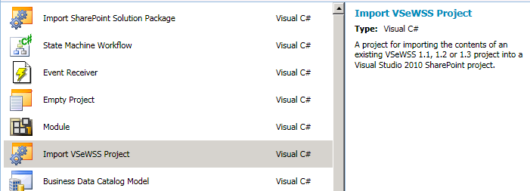
VSeWSS Import Project Template
Import VSeWSS 1.1 and up
Shipped separately from VS2010
VB.NET and C#
Supports Full Trust and Sandboxed projects
Notes:
The Import VSeWSS template will ship separately. Currently there are two Visual Studio extensions (VSIX files). One for C# the other for VB.NET. You can install these extensions a per-user basis.
When running the import wizard one of the first major choices to make is whether to deploy as a sandboxed or as a full trust solution. The development is the same for each of these, but the artifacts that you are allowed to deploy to differ. Good examples to mention are User Controls deployed to the CONTROLTEMPLATES folder or files deployed to the LAYOUTS directory. Sandboxed deployment does not allow this type of content (generally, it only allows site and site-collection level artifacts).
When you choose to deploy sandboxed while you also deploy files to a directory such as LAYOUTS, there will be an import error. While this error does not stop the overall import process, you should address the issue. To resolve it you can open the Property window for the SharePoint project and reconfigure the deployment type.

Slide 5
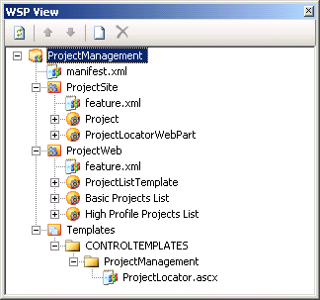
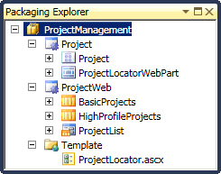
Start and Finish
WSP View in VSeWSS
Packaging Explorer in VS2010
Feature layout matches source
Notes:
This is a sample of the WSP view from VSeWSS 1.3 and the Packaging Explorer in Visual Studio 2010. Both serve a similar goal. That is to view and structure the WSP package that is created from the project contents.
In VSeWSS the WSP View was also used to provide access to the feature.xml and manifest.xml files. In Visual Studio 2010 this is no longer the case. These SharePoint artifacts are not designable directly from the Solution Explorer together with the other project content. This provides a more seamless experience when editing project content (in VSeWSS, these files were not actually part of the project but maintained separately).
Although the project structure remains intact, that does not mean that the content is still the same. Most of the paradigms of VSeWSS no longer apply to Visual Studio 2010. Good examples are Web Part definitions (.webpart files). In VSeWSS the class name was replaced at packaging time by matching a GUID in the .webpart file with the value of a GuidAttribute applied to the Web Part class inside the code file. This allowed the developer to change the Web Part class name which would be automatically translated into the .webpart file. (e.g. instead of having to maintain a matched class name in the code file and the .webpart file, you need to maintain matching GUIDs. Of course it was easy to accidentally change the value for this GUID in either the .webpart or in the .cs file, resulting in packaging errors.
Visual Studio 2010 uses a different system more in tune with how Visual Studio templates work in general. Instead of a GUID that is matched with a class the system now employs tokens delimited with dollar signs, like $SharePoint.Project.AssemblyFullName$ to reference the fully qualified assembly name. There is also deeper integration with Visual Studio, for instance with the refactoring subsystem. This allows the project system to automatically sync the .webpart file with the actuall class name used in the code file.

Slide 6
SharePoint Project Items (SPIs)
Visual Studio 2010 provides flexibility to packaging
Group SPIs conceptually in features
A SharePoint SPI:
Is stored in its own folder
Defines one artifact in the <Elements> file
The folder has the type identifier as metadata
Commonly contains the associated code in the same folder
Notes:
There are some things notably different between how artifacts are structured in VSeWSS and how they should be structured in Visual Studio 2010. The core idea behind the Visual Studio 2010 SharePoint Tools is extensibility. You can create your own project and item templates easily, you can then extend the project system with custom code. The projects and items available out of the box follow this exact model.
The core concept of the SharePoint Tools is the SharePoint Project Item, or SPI. The Add New Item dialog basically allows you to add new SPIs to the SharePoint project. Conceptually can think of an SPI as a single <Module>, <CustomAction> or Web Part. An SPI has an associated folder, the folder name being the name of the SPI. Next the SPI has associated meta-data, maintained in a separate file in the SPI folder. This meta-data file is commonly hidden but can be made visible in the Solution Explorer. It is this meta-data that allows the extensibility system to hook custom code up with specific types of project items. A good example to mention is the <Module> item. When you drop new files into the folder, it is automatically added to the files deployed with the module. So, in order to provide extensibility correctly to the items in the projects, it is important that each artifact separated into its own SPI folder. Although combining artifacts does not break anything.

Slide 7
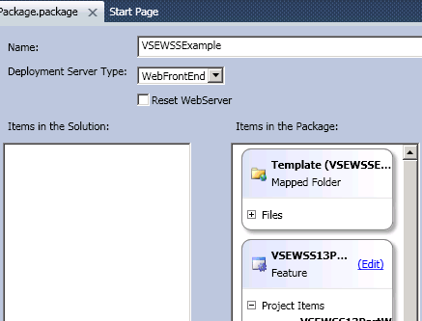
Visual Studio 2010 Designers
Feature Designer
Combine SharePoint artifacts into a feature
Zero or more features per project
Packaging Explorer
Add / remove features from entire solution
Package custom assemblies
One package per SharePoint project
Notes:
The first version of VSeWSS hid the feature.xml and manifest.xml files. Later versions made these files editable (through the WSP View). These files are now part of the project model and are available through the Solution Explorer. Out of the box there is also a visual designer for both the feature and the package.
The approach to the packaging is different from VSeWSS. There is a separate template file that is used as the basis for generating content at compile time. You can edit the template to combine hard-coded elements with dynamic project content. It is also possible to turn off the designers and instead create the feature.xml and manifest.xml files manually, although it is not expected that you will need to do that for all but the most specific scenarios.

Slide 8
Upgrading Projects to SharePoint 2010

Slide 9
Deprecated and New Features
Important features that are deprecated
STP files for sites
Toolbar User Interface
Important features that are added
Fluent User Interface
XSLT-based List Rendering
Large List Throttling
Notes:
In each new version of a product certain features get deprecated and replaced with a more advanced alternative. SharePoint 2010 is no different. One key area of customer investment are STP files as the storage container for portable site templates. Although not generally deployed as part of a developed solution it is a hot item. Instead of STP files for packaging site templates the WSP file format is now the common container for storing SharePoint customizations, including site templates. The WSP format is used throughout the Office productivity stack and in Visual Studio as well. The Save Site as Template command saves the site as a WSP file and stores it in the Site Assets library. You can still import STP files into SharePoint 2010.
Another big investment area is the Fluent user experience provided in part by the ribbon and common dialogs framework. Many customizations need an area to surface in the user interface and have customized the toolbars provided in WSS 3.0. These investments will mostly work in the SharePoint 2010 UI.
The throttling of large list is an important new feature that might cause concern. When there is code operating on large amounts of data you might hit the new throttle limit set by the administrator and get an exception where earlier you would get your data, but slowly and with a high toll on the farm.

Slide 10
Upgrading STP Files
STP
Create Site
Upgrade to 2010
Resolve issues
Save as template
WSP
Notes:
When you have existing investment in STP files for site templates the approach to upgrade to the 2010 model using WSP files is as follows. First you create a site based on the STP template. You can then convert the UI into the 2010 equivalent (there is more background on UI modes later in this deck). After you have changed the site to your needs, save it as a template again. Now you have a WSP that can be used for SharePoint 2010 and vNext.

Slide 11
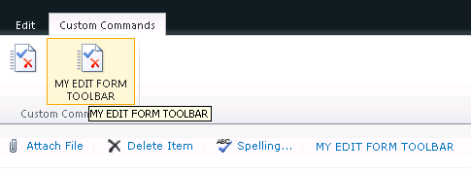
From Toolbar to Ribbon
Switch from Toolbar to Ribbon UI
Toolbar actions are moved to Custom Commands tab
Similar to Office client
Possible to show toolbar in list forms
Code-based actions do not migrate
Notes:
SharePoint 2010 provides an auto-upgrade model for UI artifacts similar to what Office 2007 provided when it moved from toolbars to the ribbon. Custom commands are moved to a separate tab. This ensures that existing SharePoint 2007 applications can continue to run on SharePoint 2010. In order to get the most out of the product UI upgrade is recommended.

Slide 12
Deprecated APIs
SharePoint 2010 introduces new APIs and deprecates others
Deprecated does not always unsupported
Results in compiler warnings (breaks build with Treat Warnings as Error)
Many APIs deprecated since WSS 3.0 are still available
PowerShell commandlets instead of STSADM commands
Notes:
API deprecation is a built-in feature of the .NET Framework and allows you to indicate which APIs will no longer be improved. Wwhen you recompile your custom application to the new version of SharePoint you might get compiler warnings indicating which APIs should no longer be used. Commonly there is information in the warning directing the developer to new APIs that should be used instead. SharePoint 2007 deprecated SPVirtualServer in favor of the SPWebApplication and SPIisSettings classes.
In SharePoint 2010 there are similar APIs. Shared Service Providers are deprecated in favor of the new Service Application Model. The Business Connectivity Services API is part of the core SharePoint assembly.
Not directly related to most of the custom code created for SharePoint are changes to the administrative commands. The STSADM management tool is replaced with a wide variety of SharePoint commands.
In order to show all SharePoint commands you can run the following script inside the SharePoint Management Console. Get-Command | Where-Object { $_ -like “*-SP*”} | more

Slide 13
Working with Compiled Code
IIS
Binding redirects provided from WSS 3.0 to SharePoint 2010
Timer Service
No binding redirects, recompile required
Custom Apps
Provide own binding redirects or recompile
Compiling your project:
Build for the x64 platform
Target .NET Framework 3.5 SP1
Notes:
The .NET Framework provides binding redirects to redirect assemblies that are compiled against v1 of a referenced component and at runtime execute against a different version of that component. For SharePoint this allows a customization that targeted SharePoint 2003 or SharePoint 2007 to work inside SharePoint 2010 without recompilation (whether there will be unforeseen issues is of course not known and should be tested)

Slide 14
Other Considerations
Assembly references
x86 / x64 COM references
TypeForwardedTo attribute moves classes to other assemblies
HTTP Handler / HTTP Module registrations in IIS7 integrated pipeline
Notes:
There are many different areas of concerns given the wide variety of solutions that people create. Only proper research can give guarantees on your solution running successfully on SharePoint 2010.

Slide 15
Update SharePoint 2007 Constants
New installation folders c:\Program Files\Common Files\Microsoft Shared\Web Server Extensions\14 c:\Program Files\Microsoft Office Servers\14.0 c:\Program Files\Microsoft Office\Office14
New registry roots HKLM\Software\Microsoft\Shared Tools\Web Server Extensions\14.0 HKLM\Software\Microsoft\Office Server\14.0
Notes:
With a new version of SharePoint also comes a new installation folder. Any code referencing the old installation folder should be updated to reference SharePoint 2010. The same goes for registry keys that might be read information about SharePoint installations. Information such as the install location of SharePoint 2010.

Slide 16
Integrating with SharePoint 2010

Slide 17
Backwards Compatible UI
Per site configuration of UI mode
SP2007
SP2010
3.0 UI
3.0 UI Mode
2010 UI
Toolbars
3.0 CSS
3.0 Themes
No Interactive calendars
No In-Place Wiki edits
No Ribbon
2010 Development
Notes:
In order to minimize both the administrative and developer impact of the new Fluent interface of SharePoint 2010 the WSS 3.0 user interface is still supported. The end-user experience is not as rich as when using the 2010 UI.
For those moving from 2007 to 2010 this will be an important feature. One that was notably missing in the Office 2007 client. However, the SharePoint 2010 timeframe is the time to upgrade your investment in the old WSS 3.0 interface.

Slide 18



Administrating User Experiences
Site Collection Administration
Hide Site Administration
Upgrade all sites to 2010 mode
No turning back
Site Administration
Preview
Upgrade
No turning back
Notes:
If setting has not been updated
Default after upgrade – WSS 3.0
Preview mode for testing – additional information on the site
2010 mode – committed – no way from UI to go back – from OM still possible

Slide 19
UI Versioning in the SharePoint OM
Use code to toggle UI version
SPSite.UIVersionConfigurationEnabeled
SPWeb.UIVersion
SPWeb.UIVersionConfigurationEnabled
UI versions 3 and 4 are allowed
For preview mode, UI Version is 4 and configuration is enabled
Notes:
The SharePoint object model has support for UI versioning at both the site collection and site level. You can easily toggle the active UI version, including reverting back from 2010 to 3.0 mode. You can also check the same boxes as in the SharePoint settings pages, allowing you to hide the UI version picker controls at the site collection and site level.

Slide 20
ASP.NET Versioned Controls
VersionedPlaceHolder
Hidden during Render
UIVersionedContent
Hidden during control creation
<SharePoint:VersionedPlaceHolder runat=”server” UIVersion=”4”>
<asp:Label runat=”server” Text=”Content” />
</SharePoint:VersionedPlaceHolder>
<SharePoint:UIVersionedContent runat=”server” UIVersion=”4”>
<ContentTemplate>
<asp:Label runat=”server” Text=”Content” />
</ContentTemplate>
</SharePoint:UIVersionedContent>
Notes:
In order to provide a seamless experience across all current and future UI version you can target specific content for specific version. You can choose to use the VersionedPlaceHolder, which, when the version is not equal to the configured version on the place holder does not render its content. The UIVersionedContent place holder hides the content earlier in the page lifecycle by not adding the place holder content into the control hierarchy when versions do not match A big difference is that the content of the VersionedPlaceHolder takes part in the page lifecycle, scripts can be registered independent of the UI version.

Slide 21
Markup Overhaul
Stylesheet Changes
CSS structure totally rebuilt
WSS 3.0 CSS used for v3 UI Mode
Script Changes
JavaScript minification
Markup Compliancy
XHTML
WCAG 2.0 AA
Notes:
One of the big areas of improvement is the usage of CSS in SharePoint. The CSS has been overhauled to make it easier to work with and change. Other areas of improvement revolve around delivering JavaScript to the client. Script can now be deliverd minified, saving on the amount of network communication needed to get the scripts to the client. The final area relating to the markup that SharePoint generates is compliancy with web standards. SharePoint generates XHTML WCAG 2.0 AA compatible markup.
Web Content Accessibility Guidelines (WCAG) 2.0 defines how to make Web content more accessible to people with disabilities. Accessibility involves a wide range of disabilities, including visual, auditory, physical, speech, cognitive, language, learning, and neurological disabilities. Although these guidelines cover a wide range of issues, they are not able to address the needs of people with all types, degrees, and combinations of disability. These guidelines also make Web content more usable by older individuals with changing abilities due to aging and often improve usability for users in general.

Slide 22
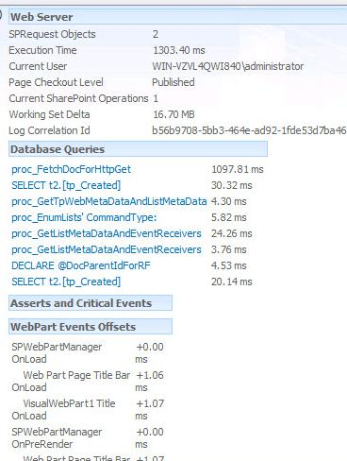
Developer Dashboard
Displays developer information about page rendering
Programmable through SPMonitoredScope
using(SPMonitoredScope scope = new SPMonitoredScope(“Message”)) { // code goes here }
Notes:
A huge improvement for developers is the Developer Dashboard. The dashboard gives insight into what code has executed to render a specific page, including information about the ASP.NET page lifecycle, the number of SQL queries and other details. In earlier versions of SharePoint it was difficult to determine why a page would render slow.
The dashboard can be configured to either not show at all, show when asked using a button in the Ribbon, or to always show.
Developers can make write content to the dashboard using the SPMonitoredScope class, which allows a developer to monitor his custom code running inside SharePoint.

Slide 23
Summary
Upgrading Projects to Visual Studio 2010
Upgrading Projects to SharePoint 2010
Integrating with SharePoint 2010

